Slide 1
Barchart Infographics
100%
50%
25%
Here is where this template begins
75%
This template has been created by Slidesgo

Slide 2
Barchart Infographics
Earth
Mars
100%
50%
50%
75%
25%
100%
Earth is the third planet from the Sun and the only one that harbors life in the Solar System. All humans live on this planet
Despite being red, Mars is actually a cold place. It’s full of iron oxide dust, which gives the planet its reddish cast
This template has been created by Slidesgo

Slide 3
Barchart Infographics
100%
Earth
Mercury
Earth is the only planet that harbors life
Mercury is the closest planet to the Sun
50%
25%
Saturn
Jupiter
Saturn is a gas giant and has several rings
Jupiter is the biggest planet of them all
75%
This template has been created by Slidesgo

Slide 4
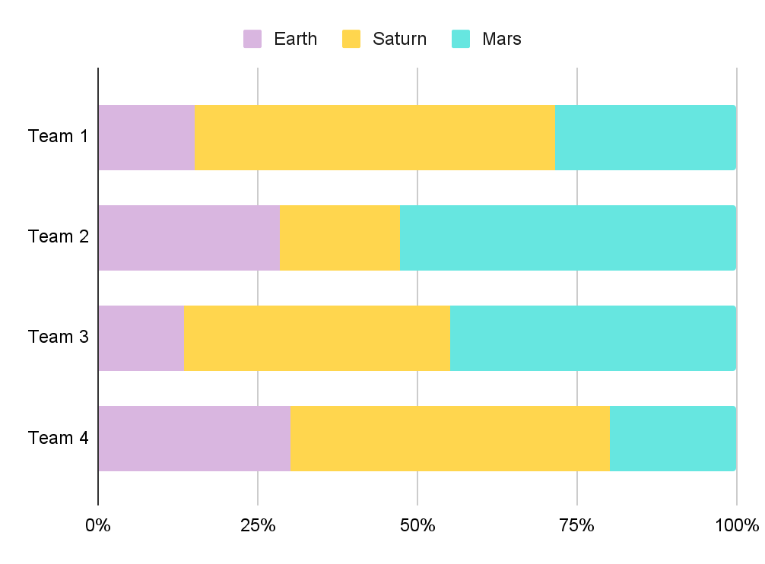
Barchart Infographics
Earth
Earth is the third planet from the Sun and has life
Saturn
Saturn has a high number of moons, like Jupiter
Mars
Despite being red, Mars is actually a cold place
Follow the link in the graph to modify its data and then paste the new one here. For more info, click here
This template has been created by Slidesgo

Slide 5
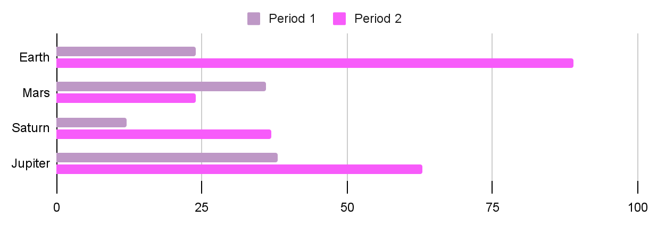
Barchart Infographics
Earth
Mars
Saturn
Jupiter
Earth is the planet with life
Mars is full of iron oxide dust
Saturn is the ringed planet
Jupiter is a huge gas giant
Follow the link in the graph to modify its data and then paste the new one here. For more info, click here
This template has been created by Slidesgo

Slide 6
Barchart Infographics
100%
Earth
Earth is the third planet from the Sun and the only one that harbors life in the Solar System. All humans live on this planet
50%
25%
100%
Mars
Despite being red, Mars is actually a cold place. It’s full of iron oxide dust, which gives the planet its reddish cast
75%
50%
This template has been created by Slidesgo

Slide 7
Barchart Infographics
50%
100%
50%
90%
50%
25%
25%
75%
80%
Earth
Mercury
Saturn
Earth is the only planet that harbors life
Mercury is the closest planet to the Sun
Saturn is a gas giant and has several rings
This template has been created by Slidesgo

Slide 8
Barchart Infographics
50%
Mercury
Mercury is the smallest planet of them all
100%
Venus
Venus is the second planet from the Sun
25%
Earth
Earth is the only planet that harbors life
75%
Mars
Despite being red, Mars is very cold
This template has been created by Slidesgo

Slide 9
Barchart Infographics
100%
Mars
Despite being red, Mars is actually a cold place. It’s full of iron oxide dust, which gives the planet its reddish cast
50%
25%
75%
50%
75%
Earth
Earth is the third planet from the Sun and the only one that harbors life in the Solar System. All humans live on this planet
25%
100%
This template has been created by Slidesgo

Slide 10
Barchart Infographics
100%
90%
Venus
Venus has a beautiful name and is the second planet from the Sun. It’s terribly hot, even hotter than Mercury, and its atmosphere is extremely poisonous. It’s the second-brightest natural object in the night sky after the Moon
70%
50%
30%
10%
This template has been created by Slidesgo

Slide 11
Barchart Infographics
Earth
Mercury
100%
75%
50%
25%
25%
50%
Earth is the only planet that harbors life
Mercury is the closest planet to the Sun
Saturn
Mars
50%
75%
75%
50%
25%
100%
Saturn is a gas giant and has several rings
Despite being red, Mars is very cold
This template has been created by Slidesgo

Slide 12
Barchart Infographics
Earth
Mars
Earth is the third planet from the Sun and the only one that harbors life in the Solar System. All humans live on this planet
Despite being red, Mars is actually a cold place. It’s full of iron oxide dust, which gives the planet its reddish cast
90%
Mercury
90%
75%
Venus
75%
25%
Jupiter
25%
50%
Saturn
50%
100%
Neptune
100%
This template has been created by Slidesgo

Slide 13
Barchart Infographics
100%
90%
Mercury
Mars
Mercury is the smallest planet of them all
Despite being red, Mars is very cold
50%
75%
Venus
Jupiter
Venus is the second planet from the Sun
Jupiter was named after a Roman god
25%
50%
Earth
Saturn
Earth is the only planet that harbors life
Saturn was named after a Roman god
This template has been created by Slidesgo

Slide 14
Barchart Infographics
60%
62.5%
80%
Earth
Earth is the third planet from the Sun and has life
40%
70%
90%
80%
80%
Saturn
Saturn has a high number of moons, like Jupiter
50%
100%
This template has been created by Slidesgo

Slide 15
Barchart Infographics
90%
50%
75%
100%
100%
25%
50%
75%
25%
90%
Earth
Mars
Saturn
Jupiter
Mercury
Earth is the planet with life
Mars is full of iron oxide dust
Saturn is the ringed planet
Jupiter is a huge gas giant
Mercury is a small planet
This template has been created by Slidesgo

Slide 16
Barchart Infographics
Earth
Mars
Saturn
Jupiter
Earth is the planet with life
Mars is full of iron oxide dust
Saturn is the ringed planet
Jupiter is a huge gas giant
75%
25%
25%
50%
VS
100%
75%
50%
100%
This template has been created by Slidesgo

Slide 17
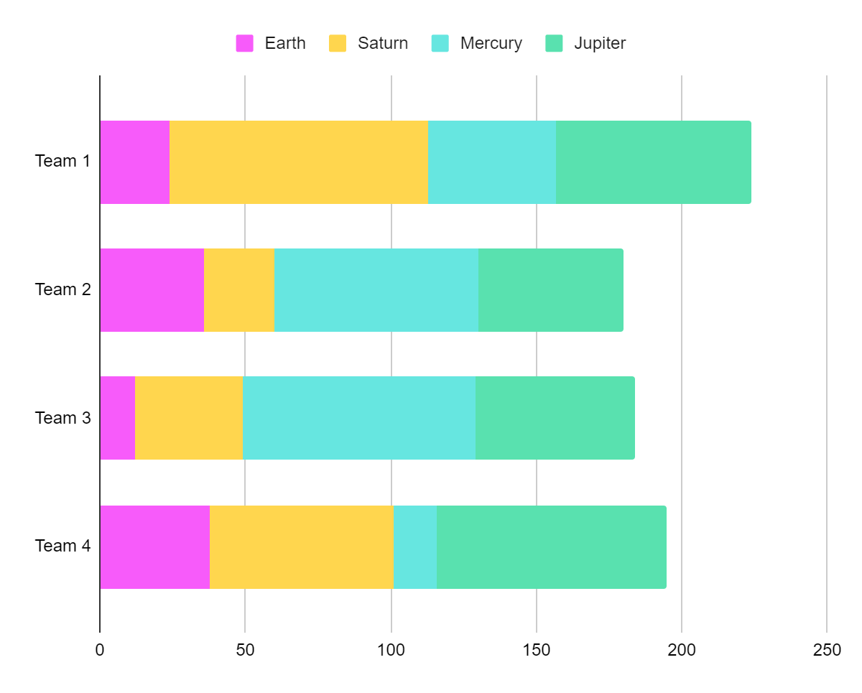
Barchart Infographics
Earth
Mercury
Earth is the only planet that harbors life
Mercury is the closest planet to the Sun
Saturn
Jupiter
Saturn is a gas giant and has several rings
Jupiter is the biggest planet of them all
Follow the link in the graph to modify its data and then paste the new one here. For more info, click here
This template has been created by Slidesgo

Slide 18
Barchart Infographics
0
1
2
3
4
5
6
7
8
9
10
Earth
Mars
Saturn
Jupiter
Earth is the planet with life
Mars is full of iron oxide dust
Saturn is the ringed planet
Jupiter is a huge gas giant
This template has been created by Slidesgo

Slide 19
Barchart Infographics
Mercury
100%
Earth
Venus
Venus has a beautiful name and is the second planet from the Sun. It’s terribly hot, even hotter than Mercury, and its atmosphere is extremely poisonous. It’s the second-brightest natural object in the night sky after the Moon
50%
Mars
25%
Jupiter
75%
Saturn
90%
This template has been created by Slidesgo

Slide 20
Icon pack
This template has been created by Slidesgo

Slide 21
Instructions for use (premium users)
As a Premium user, you can use this template without attributing Slidesgo
You are allowed to:
Modify this template
Use it for both personal and commercial projects
Share this template in an
editable format
Hide or delete the “Thanks” slide and the mention to Slidesgo in the credits
You are not allowed to:
Sublicense, sell or rent any of Slidesgo Content
Distribute Slidesgo Content unless it has been expressly authorized by Slidesgo
Use any of the elements that are part in a separated way
Register any of the elements as a trademark or logo in an intellectual property registry
For more information about editing slides, please read our FAQs or visit our blog

Slide 22
Infographics
You can add and edit some infographics to your presentation to present your data in a visual way.
Choose your favourite infographic and insert it in your presentation using Ctrl C + Ctrl V or Cmd C + Cmd V in Mac
Remember to choose the “Keep source formatting” option so that it keeps the design. For more info, please visit our blog
01
07
Select one of the parts and ungroup it by right-clicking and choosing “Ungroup”
Repeat the steps above with the other parts and when you’re done editing, copy the end result and paste it into your presentation
02
06
03
Change the color by clicking
on the paint bucket
05
Group the elements again by selecting them, right-clicking and choosing “Group”
Then resize the element by clicking and dragging one of the square-shaped points of its bounding box (the cursor should look like a double-headed arrow). Remember to hold Shift while dragging to keep the proportions
04

